Slide 1


WEBSITE PROTOTYPE PRESENTED BY
TRAVEL CANADA®
© Copyright All Rights Reserved
March 30, 2021

Slide 2
Our Team
Tamika Lewis Lead Project Manager Jinyi Zhang Senior Frontend Developer Oswaldo Baron Matamoros Senior Backend Developer Jonn Malmqvist Front-end Developer & Digital Marketing Specialist
TRAVEL CANADA®
March 30, 2021

Slide 3

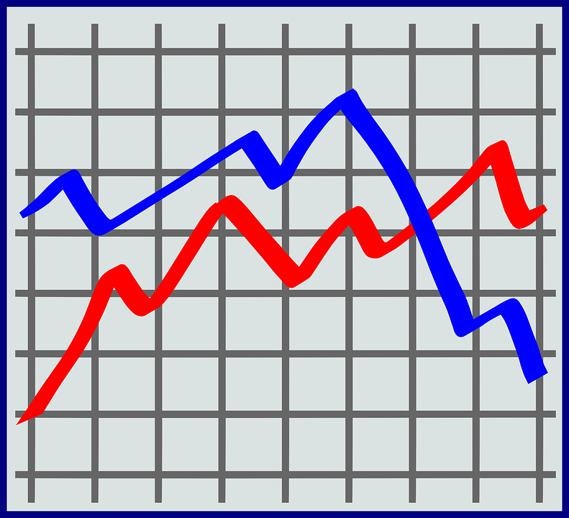



SOLUTION HIGHLIGHTS
Graphical Interface
Data Migration
Data Storage
Commission
Tracker
Market Data
Analytics
Training
Secure Access
Opportunities
TRAVEL CANADA®
March 30, 2021

Slide 4



Technologies
FRONT-END
MIDDLEWARE
BACK-END
<%=EJS %>
TRAVEL CANADA®
March 30, 2021

Slide 5
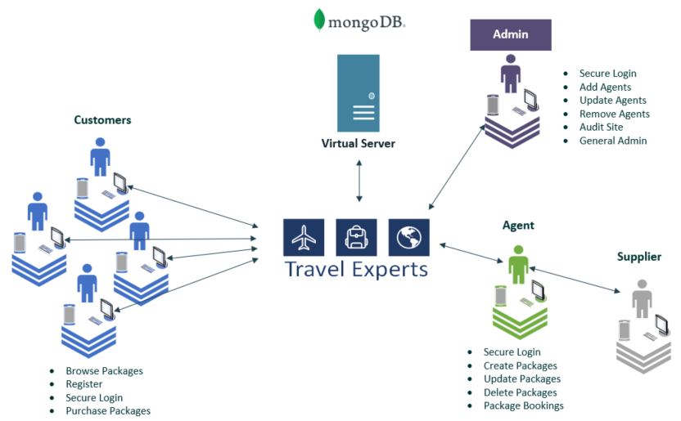
PROTOTYPE
(Use Case)
TRAVEL CANADA®
March 30, 2021

Slide 6
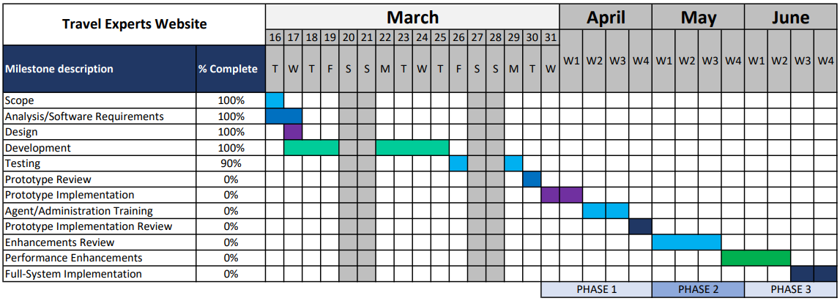
PROJECT SCHEDULE
TRAVEL CANADA®

Slide 7

WEBSITE
DEMONSTRATION
March 30, 2021

Slide 8

QUESTIONS?
March 30, 2021

